Slide 1
Advanced Operating Systems
(Memory Management in Linux)
Sang Gue Oh, Ph.D.
Email : sgoh@macroimpact.com

Slide 2
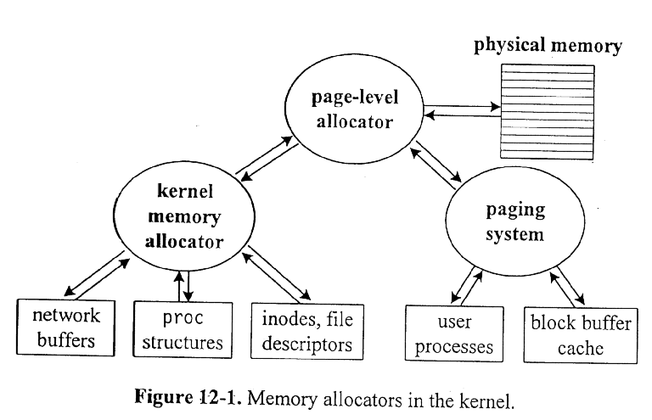
Memory Allocators in the Kernel

Slide 3
Dynamic Memory Allocators in Linux
Page-level allocator : get_free_page()
  Allocate the requested number of contiguous free pages.
Kernel memory allocators
  Contiguous allocation of arbitrary length up to 128 KB : kmalloc()
    Allocate sequences of memory cells having contiguous physical addresses and an arbitrary length.
  Non-contiguous allocation : vmalloc()
Non-Contiguous Allocation
Contiguous Allocation
Slab Allocator
Page-level Allocation
Buddy System

Slide 4
Requesting and Releasing Page Frames
Allocating page frames
  __get_free_pages(gfp_mask, order)
    Function used to request 2^{order} contiguous page frames.
  __get_dma_pages(gfp_mask, order)
    Macro used to get 2^{order} page frames suitable for DMA.
  __get_free_page(gfp_mask)
    Macro used to get a single page frame.
  get_free_page(gfp_mask)
    Function that invokes __get_free_page(gfp_mask) and fills with zeros.
Releasing page frames
  free_pages(addr, order)
    Function used to free 2^{order} page frames starting from address addr.
  __free_page(p)
    Function used to free a page frame whose descriptor is pointed by p.
  free_page(addr)
    Macro used to release a page frame having physical address addr.

Slide 5
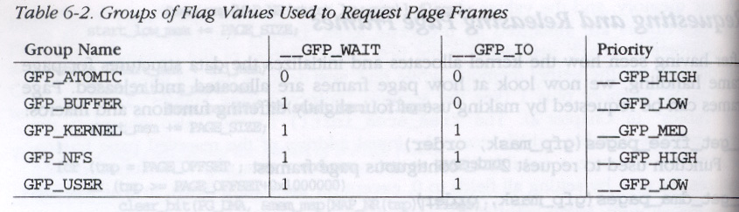
GFP_MASK Parameter
__GFP_WAIT : Set if the kernel is allowed to discard the contents of page frames in order to free memory before satisfying the request.
__GFP_IO : Set if the kernel is allowed to write pages to disk in order to free the corresponding page frames.
__GFP_DMA : Set of the requested page frames must be suitable for DMA.
__GFP_HIGH, __GFP_MED, __GFP_LOW : Request priority.
Groups of Flag values used to request page frames

Slide 6
Data Structures for Physical Page Frames
mem_map_t (include/linux/mm.h)
  Describe a single physical page in the system.
    count - number of users. 0 if the page is free.
    flags – 32 flags describing the status of the page frame.
    map_nr - physical page frame number.
    typedef struct page {
    struct page*next; struct page *prev;
    struct inode *inode; unsigned long offset;
    struct page *next_hash;
    atomic_t count; unsigned flags;
    unsigned dirty:16, age:8;
    struct wait_queue *wait; struct page *prev_hash;
    struct buffer_head *buffers;
        unsigned long swap_unlock_entry;
    unsigned long map_nr;
    } mem_map_t;
mem_map (mm/memory.c)
  all of the physical pages.
  a list of mem_map_t. Initialized at boot time.

Slide 7
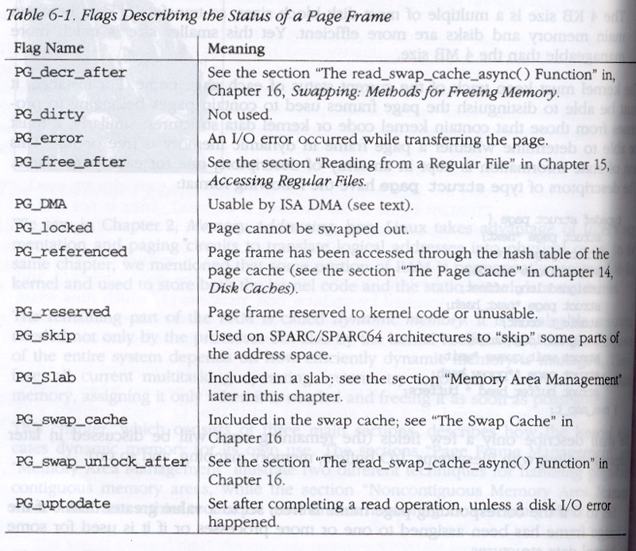
Flags for Page Frame

Slide 8
Page Allocator - Buddy System Algorithm
All free page frames are grouped into 10 free lists of blocks that contain groups of 1, 2, 4, 8, 16, 32, 64, 128, 256, and 512 contiguous page frames. Allocate in blocks of powers of 2 in size.
The physical address of the first page frame of a block is a multiple of the group size: e.g., the initial address of a 16-page-frame block is a multiple of 16 x 2¹².
When there exists a request a free page and there are not available page frames for that size, try to allocate the page by repeatedly halving a large buffer.
When the buffer is split, each half is called buddy of the other.
When the allocated pages are returned, try to merge free buddy blocks to create larger blocks.

Slide 9
Data Structures for Buddy Algorithm (1)
  free_area vector (/usr/src/linux/mm/page_alloc.c)
    information about blocks of contiguous free pages.
    i’th element in the array contains the pointer of 2^{i} free page blocks.
    free_area[0] points to the array of free blocks for non-DMA area.
    free_area[1] points to the array of free blocks for DMA area.
    list element
      the queue head of free blocks.
      pointers to the page data structures in the mem_map array.
    map
      bitmap which keeps track of allocated groups of pages of this size.
      Each bit of the bitmap of the k^{th} entry describes the status of two buddy blocks of size 2^{k} page frames.
        If 0, both buddy blocks are free or busy
        If 1, exactly one of the blocks is busy.

Slide 10
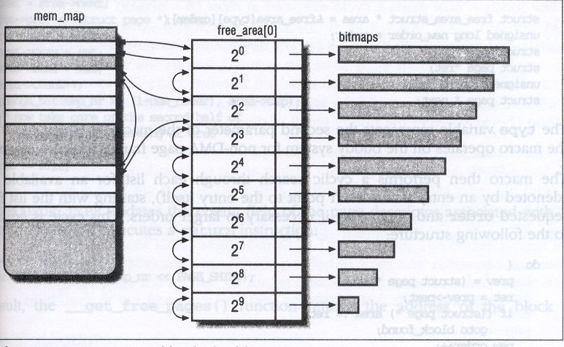
Data Structures for Buddy Algorithm (2)

Slide 11
Page Allocation/De-allocation Procedure
Allocation procedure (get_free_pages() in mm/page_alloc.c)
  Search for blocks of pages of the requested size.
  If no blocks of pages are on the free_area list, blocks of the next size are looked for.
  If the block of pages found is larger, it is broken down.
  Queue the free blocks on the appropriate queue and return the allocated block of pages.
De-allocation procedure
  A block of pages freed.
  Check the buddy (adjacent) block of the same size.
  If the buddy block is free, combine with the new free block.

Slide 12
Example – Buddy System
4 free area entries for 1, 2, 4, and 8 contiguous free pages.
Total physical memory size = 64 KB. Page size = 4 KB.
Simulate the sequence !
  Allocate 1 page.
  Allocate 4 pages.
  De-allocate 1 page.
Null
2⁰
Null
2¹
bitmap
Null
2²
8
0
2³
Page Frames
0 1 2 3 4 5 6 7 8 9 10 11 12 13 14 15

Slide 13
Slab Allocator
A slab is a chunk of memory area.
The slab allocator views this memory area as objects consisting of both a set of data structures and a couple of functions.
Each slab consists of several objects of the same type.
The slab allocator allocates a slab.
For efficiency reasons, the slab allocator does not discard the objects that have been allocated.
It treats them as caches. Therefore, each cache is a “store” of objects of the same type.
For instance, when a file is opened, the memory area needed to store the corresponding “open file” object is taken from a slab allocator cache named filp. Can be checked by /proc/slabinfo.

Slide 14
Three Design Focuses of Slab Allocator (1)
Object Reuse
  The kernel functions tend to request memory areas of the same type repeatedly (e.g., inodes, proc structure, network buffer, etc) and they occur frequently.
  Use caching and reuse the same objects.
  Fast and space efficient.
Hardware Cache Utilization
  Many processors have a small, level-1 data cache whose size is a power of 2.
  The MMU maps addresses to cache locations by
    Cache location = address % cache size;
  Objects with the same size tend to be stored at the same offset within a cache -> some portions of a cache are underutilized.
  E.g., Inode -> 300 bytes. The first 48 bytes are frequently accessed. The kernel allocates a 512-byte buffer aligned at a 512-byte boundary. Only 9 % of the physical cache is utilized.

Slide 15
Three Design Focuses of Slab Allocator (2)
Allocator Footprint
  The footprint of an allocator is the portion of the hardware cache and the TLB that is overwritten by the allocation itself.
  Many allocators must examine several objects to find a suitable buffer, which results in many cache and TLB misses and reducing the performance of the allocator.
  Need to have a small footprint.

Slide 16
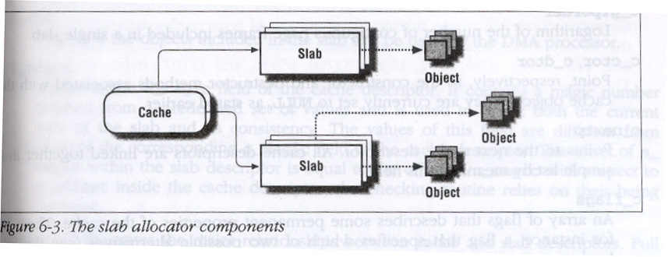
Slab Allocator Components

Slide 17
Cache Descriptor
Each cache is described by a table of type struct kmem_cache_s (mm/slab.c)
    c_name : Points to the name of the cache.
    c_firstp, c_lastp : The 1st and last slab descriptor of the cache.
    c_freep : 1st slab descriptor that includes at least one free object.
    c_num : Number of objects packed into a single slab.
    c_offset : Size of the objects included in the cache.
    c_gfporder : Logarithm of the # of contiguous page frames in a slab.
    c_ctor, c_dtor : Points to the constructor and destructor methods.
    c_nextp : Points to the next cache descriptor.
    c_flags : Permanent properties of the cache.
    c_magic : A magic # to check current status and its consistency.

Slide 18
Slab Descriptor
Each slab of a cache has its own descriptor of struct kmem_slab_s (mm/slab.c)
    s_inuse : Number of objects in the slab that are currently allocated.
    s_mem : Points to the 1st object inside the slab.
    s_free : Points to the 1st free object in the slab.
    s_nextp, s_prevp : Points to the next or previous slab descriptor.
    s_dma : Flag set if the objects can be used by the DMA processor.
    s_magic : A magic # to check current status and its consistency.
Slab descriptors can be stored in two possible places, depending on the size of the objects.
    If the size of the object < 512byte , store at the end of the slab.
    Otherwise, it is stored outside of the slab. (large objects)

Slide 19
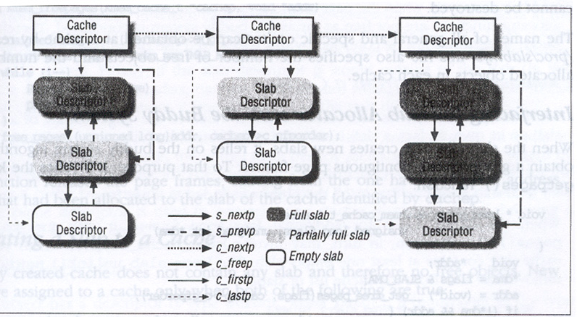
Relationship - Cache and Slab Descriptors

Slide 20
Slab Caches in Linux
Two types of caches : General cache and specific cache.
  General : used only by the slab allocator for its own purposes.
    First cache : contains the cache descriptors of the remaining caches. The cache_cache variable (mm/slab.c) contains its descriptor.
    Second cache : contains the slab descriptors that are not stored inside the slabs. The cache_slabp variable points to its descriptor.
    Thirteen additional caches : contain geometrically distributed memory areas. The table cache_sizes (mm/slab.c) whose elements are of type cache_sizes_t points to the 13 cache descriptors associated with memory areas of size 32, 64, 128, 256, 512, 1024, 2048, 4096, 8192, 16384, 32768, 65536, and 131072.
    The kmem_cache_init() and kmem_caches_sizes_init() functions are invoked during system initialization.
  Specific : used by the remaining parts of the kernel.
    Created by kmem_cache_create() function.

Slide 21
Allocating/Releasing a Slab to/from a Cache
Allocating a slab to a cache
  Invoke kmem_cache_grow(), which calls kmem_getpages() to obtain a group of page frames from the buddy system.
  The kmem_cache_slabmgmt() is invoked to get a slab descriptor.
Releasing a slab from a cache
  The slab allocator never releases the page frames of an empty slab on its own.
  It is released only if :
    The buddy system is unable to satisfy a new request for a group of page frames.
    The slab is empty, that is, all the objects included in it are free.
  Some modules of Linux may create caches. In this case, in order to avoid wasting memory space, the kernel must destroy all slabs in all caches created by a module before removing it.

Slide 22
Object Descriptor
Each object has a descriptor of type struct kmem_bufctl_s. (mm/slab.c)
  Stored in two possible ways :
    External object descriptors : stored outside of the slab.
    Internal object descriptor : stored inside of the slab.
  The Slab allocator chooses the 1st solution when the size of the objects is a multiple of 512, 1024, 2048, 4096.
  If the size is smaller than 512 bytes or not a multiple of 512, 1024, 2048, 4096, it is stored inside the slab.

Slide 23
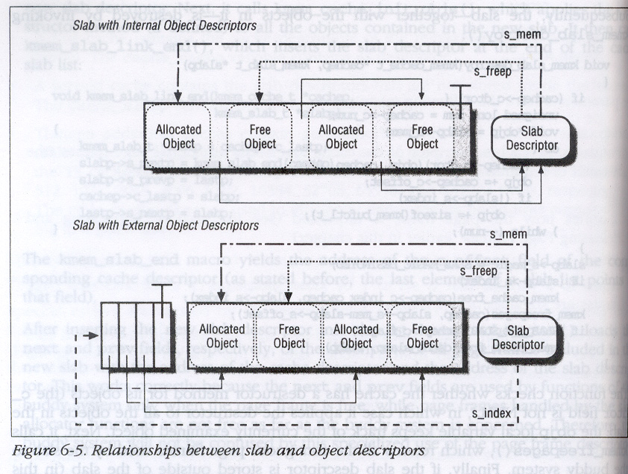
Relationship - Object and Slab Descriptors

Slide 24
Memory Alignment
The objects managed by the slab allocator can be aligned in memory whose initial addresses are multiples of a given constant.
This constant is called the alignment factor, and its value is stored in the c_align field of the cache descriptor.
If the value of c_align is 0, no alignment is required for the objects.
The largest alignment factor allowed is 4096, the page frame size.
Usually, microprocessors access memory cells more quickly if their physical addresses are aligned with respect to the word size.
Tradeoff between memory space and access time.

Slide 25
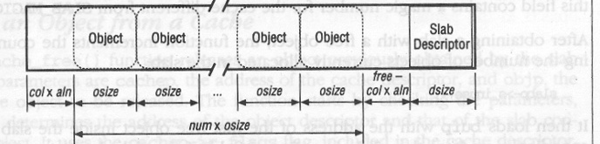
Slab Coloring
The same cache line maps many different blocks of RAM.
Objects of the same size tend to be stored at the same offset within a cache, which may result in wasting memory cycles transferring two objects from the same cache line back and forth to different RAM locations.
The slab allocator tries to reduce this unpleasant cache behavior by a policy called slab coloring.
Different arbitrary values called colors are assigned to the slabs.
Alignment
free should be larger than aln.

Slide 26
Noncontiguous Memory Area
If the requests for memory areas are infrequent, it makes sense to consider an allocation schema based on noncontiguous page frames accessed through contiguous linear addresses.
  Avoid external fragmentation.
  Difficult to handle page tables.
The size of a noncontiguous memory area must be a multiple of 4096.
Linux uses noncontiguous memory areas to allocate data structures for active swap areas, to allocate space for a module, or to allocate buffer to some I/O drivers.

Slide 27
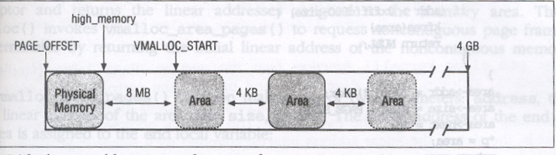
Linear Addresses of Noncontiguous Memory
To find a free range of linear addresses, the area starting from PAGE_OFFSET (fourth GB – reserved for kernel) is searched.
Available RAM occupies only a small fraction of the GB up to high_memory variable.
A safety interval of 8 MB (VMALLOC_OFFSET macro) is inserted between high_memory and the first memory for noncontiguous memory area (for out-of-bound access).
For the same reason, additional safety intervals of 4 KB are inserted to separate noncontiguous memory areas.

Slide 28
Descriptors for Noncontiguous Memory Area
Each noncontiguous memory area is associated with a descriptor of type struct vm_struct (include/linux/vmalloc.h).
The get_vm_area(unsigned long size) creates new descriptor of type struct vm_struct; its parameter size specifies the size of the new memory area.
  This function first calls kmalloc() for new descriptor.
  Then, scan the list of descriptors for an available range of of linear addresses that includes at least size+4096.
  If such an interval exists, initialize the descriptor and return the initial address of noncontiguous memory area.
  Otherwise, when addr+size exceeds the 4 GB limit, this function releases the descriptor and return NULL.

Slide 29
Allocating/Releasing a Noncontiguous Memory
Allocating a Noncontiguous Memory Area
  Use vmalloc(size) function.
    Rounding up the size value to a multiple of 4096.
    Invoke get_vm_area().
    Invoke vmalloc_area_pages() to request noncontiguous page frames.
Releasing a Noncontiguous Memory Area
  Use vfree(address) function.
    The parameter address contains the initial address of the area to be released.
    This function first scans the list pointed by vmlist to find the address of the area descriptor associated with the area to be released.
    The size field of the descriptor specifies the size of the area to be released.
    The area itself is released by invoking vmfree_area_pages(), while the descriptor is released by invoking kfree().

